Slide 1
Projective 2D geometry (cont’) course 3
Multiple View Geometry
Comp 290-089
Marc Pollefeys

Slide 2
Content
Background: Projective geometry (2D, 3D), Parameter estimation, Algorithm evaluation.
Single View: Camera model, Calibration, Single View Geometry.
Two Views: Epipolar Geometry, 3D reconstruction, Computing F, Computing structure, Plane and homographies.
Three Views: Trifocal Tensor, Computing T.
More Views: N-Linearities, Multiple view reconstruction, Bundle adjustment, auto-calibration, Dynamic SfM, Cheirality, Duality

Slide 3
Multiple View Geometry course schedule
(subject to change)
Jan. 7, 9 | Intro & motivation | Projective 2D Geometry
Jan. 14, 16 | (no course) | Projective 2D Geometry
Jan. 21, 23 | Projective 3D Geometry | Parameter Estimation
Jan. 28, 30 | Parameter Estimation | Algorithm Evaluation
Feb. 4, 6 | Camera Models | Camera Calibration
Feb. 11, 13 | Single View Geometry | Epipolar Geometry
Feb. 18, 20 | 3D reconstruction | Fund. Matrix Comp.
Feb. 25, 27 | Structure Comp. | Planes & Homographies
Mar. 4, 6 | Trifocal Tensor | Three View Reconstruction
Mar. 18, 20 | Multiple View Geometry | MultipleView Reconstruction
Mar. 25, 27 | Bundle adjustment | Papers
Apr. 1, 3 | Auto-Calibration | Papers
Apr. 8, 10 | Dynamic SfM | Papers
Apr. 15, 17 | Cheirality | Papers
Apr. 22, 24 | Duality | Project Demos

Slide 4












Last week …
Points and lines
Conics and dual conics
Projective transformations

Slide 5
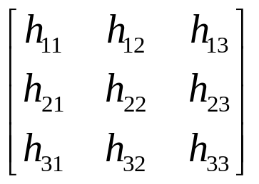
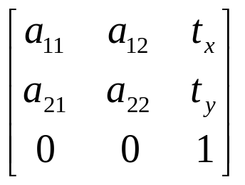
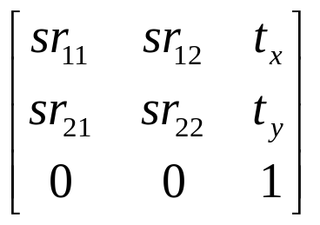
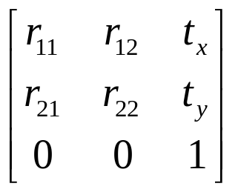
Last week …
Concurrency, collinearity, order of contact (intersection, tangency, inflection, etc.), cross ratio
Projective
8dof
Parallellism, ratio of areas, ratio of lengths on parallel lines (e.g midpoints), linear combinations of vectors (centroids).
The line at infinity l∞
Affine
6dof
Similarity
4dof
Ratios of lengths, angles.
The circular points I,J
Euclidean
3dof
lengths, areas.

Slide 6



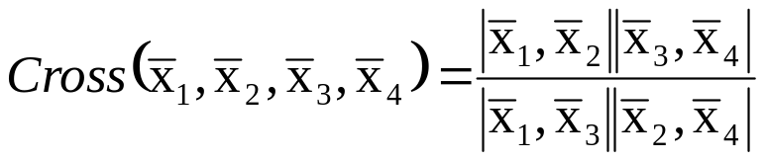
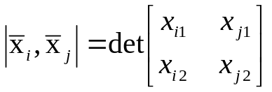
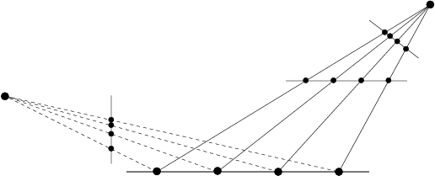
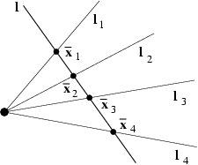
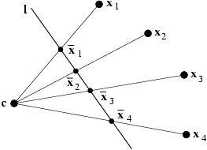
Projective geometry of 1D
3DOF (2x2-1)
The cross ratio
Invariant under projective transformations

Slide 7
Recovering metric and affine properties from images
Parallelism
Parallel length ratios
Angles
Length ratios

Slide 8
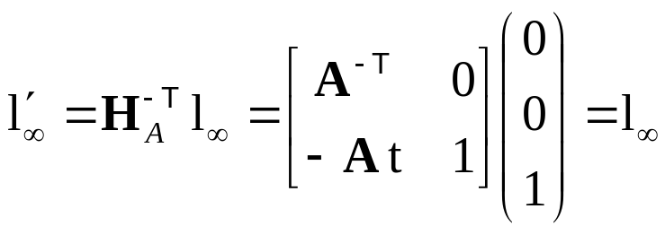
The line at infinity
The line at infinity l∞ is a fixed line under a projective transformation H if and only if H is an affinity
Note: not fixed pointwise

Slide 9
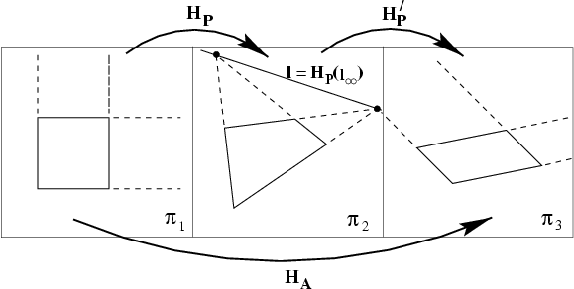
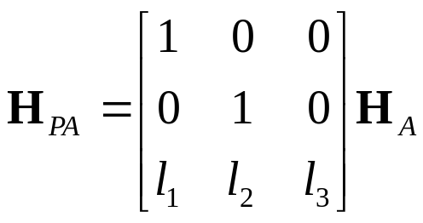

Affine properties from images
projection
rectification

Slide 10
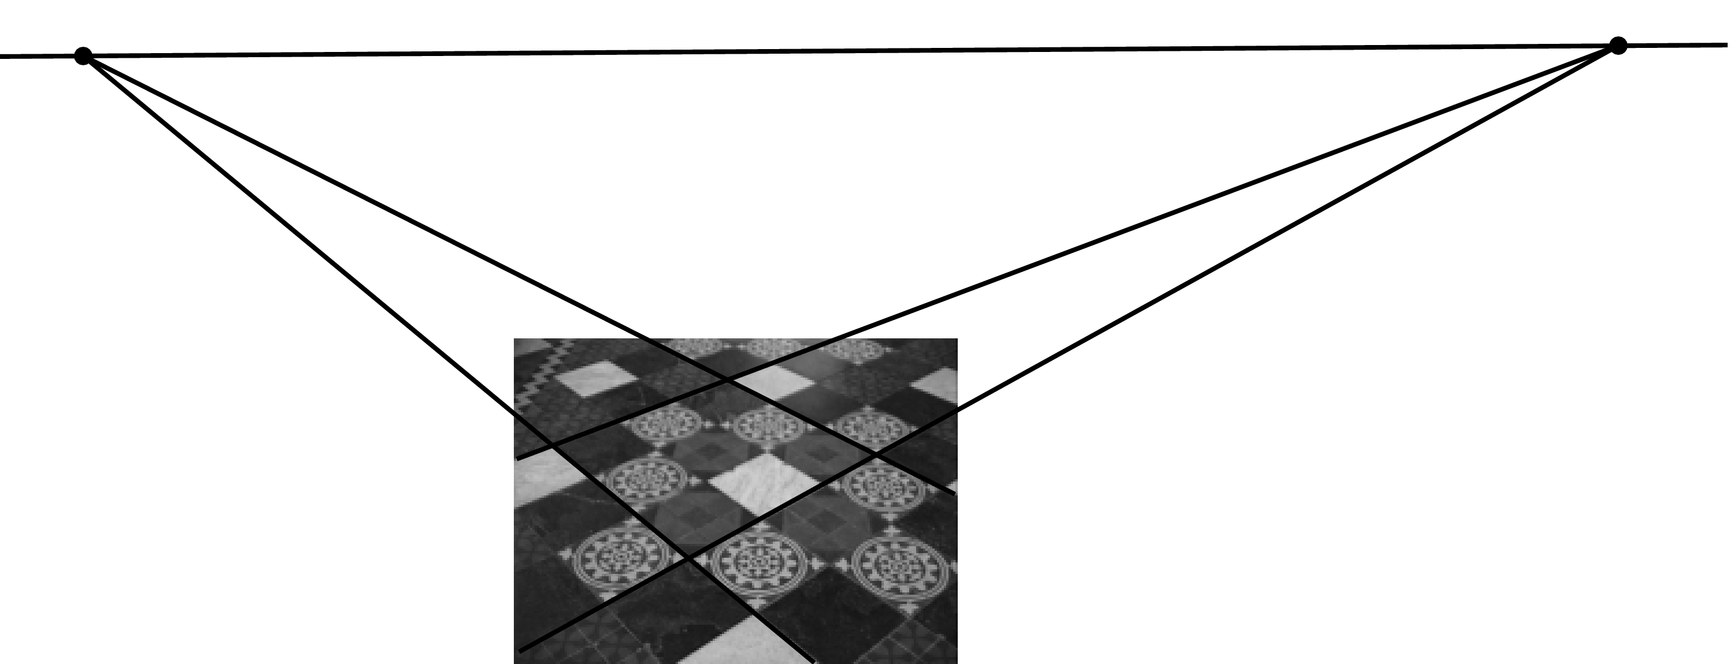



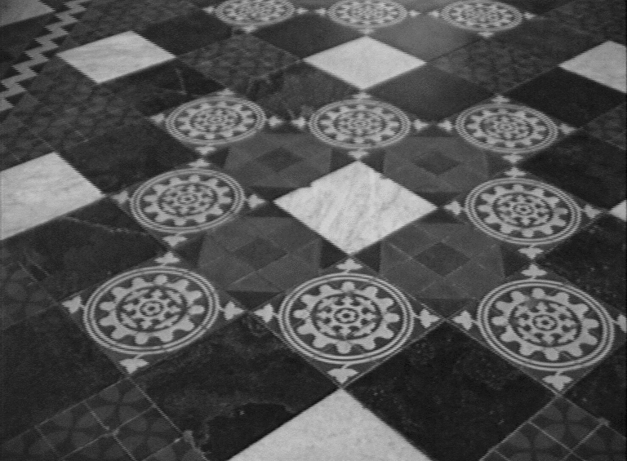
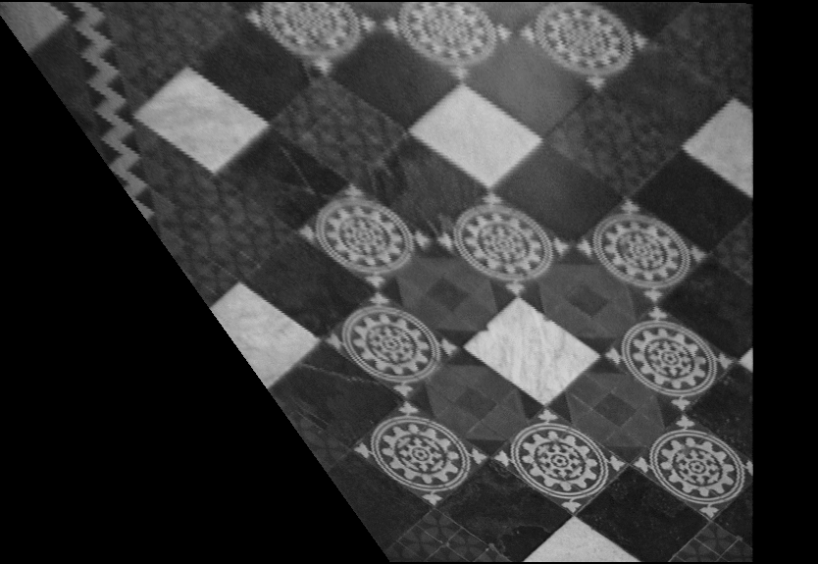
Affine rectification
v₁
l∞
v₂
l₁
l₃
l₂
l₄

Slide 11
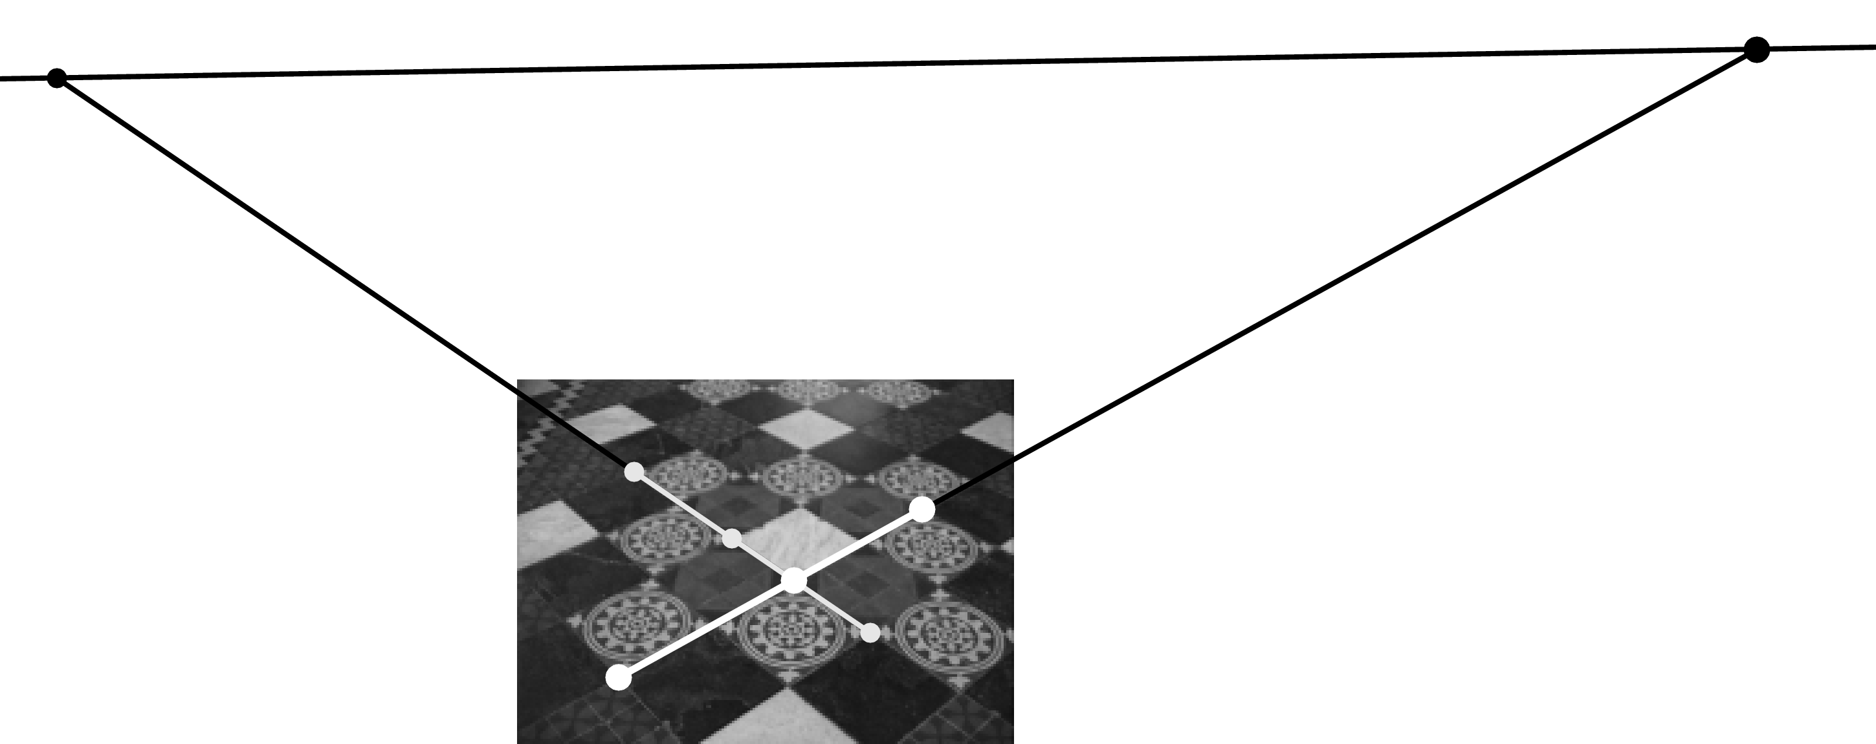


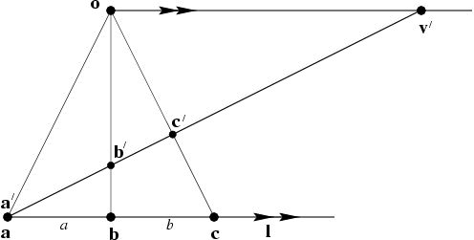



Distance ratios

Slide 12
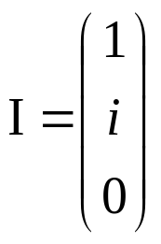
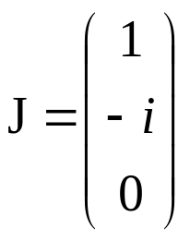
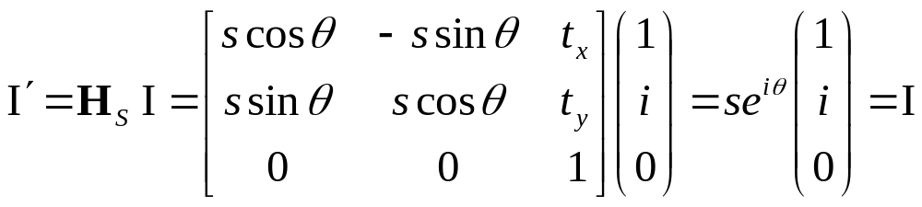
The circular points
The circular points I, J are fixed points under the projective transformation H iff H is a similarity

Slide 13
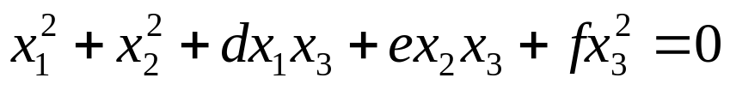
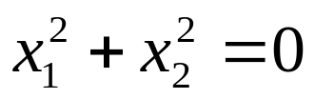
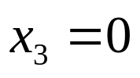
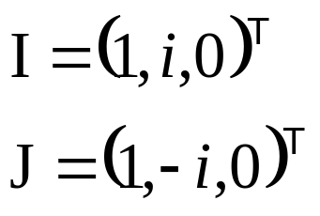
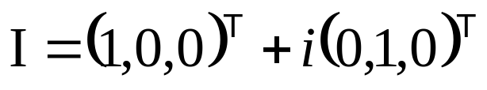
The circular points
“circular points”
l∞
Algebraically, encodes orthogonal directions

Slide 14
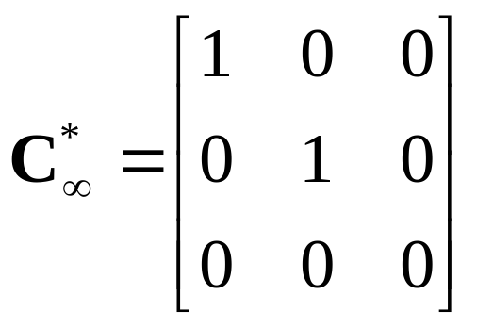
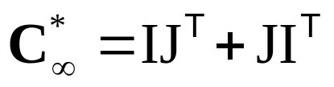
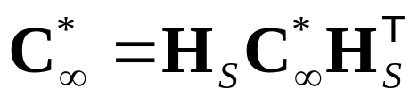
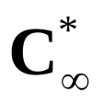
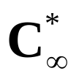
Conic dual to the circular points
The dual conic is fixed conic under the
projective transformation H iff H is a similarity
Note: has 4DOF
l∞ is the nullvector

Slide 15
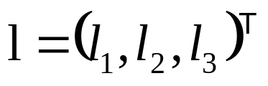
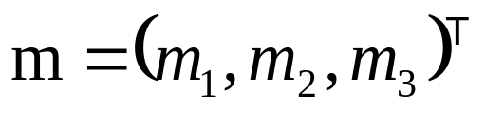
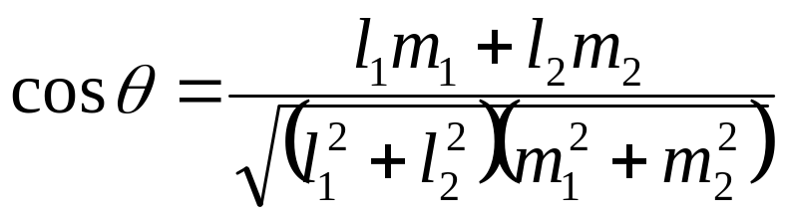
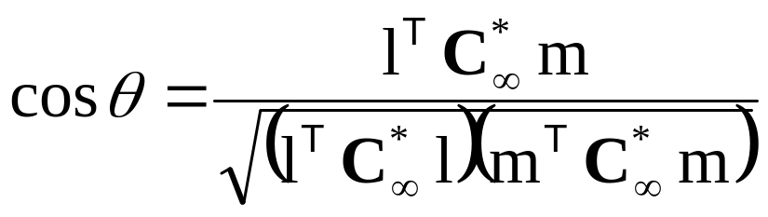
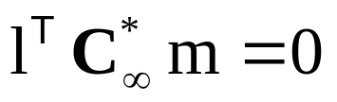
Angles
Euclidean:
Projective:
(orthogonal)

Slide 16
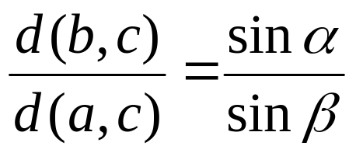
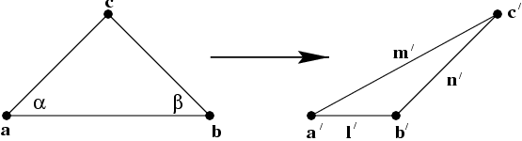
Length ratios

Slide 17
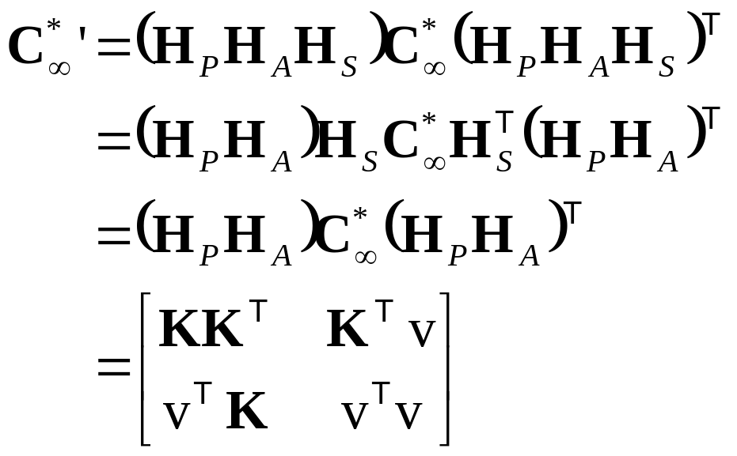
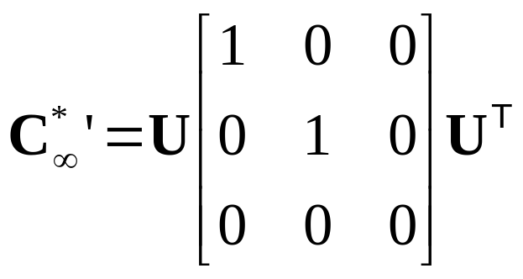

Metric properties from images
Rectifying transformation from SVD

Slide 18
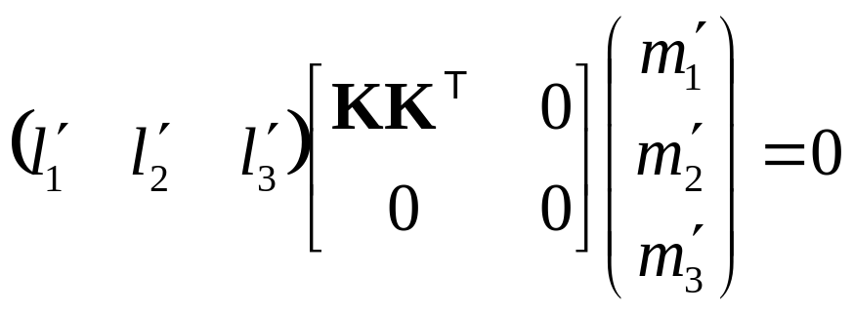

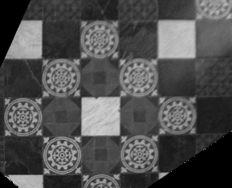
Metric from affine

Slide 19
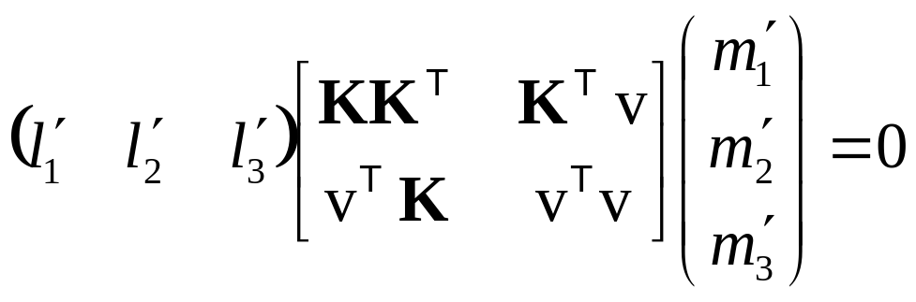
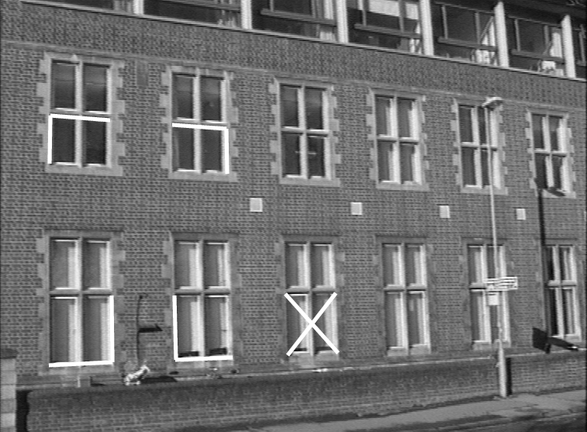
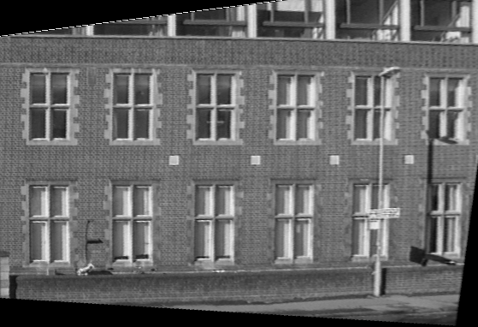
Metric from projective

Slide 20
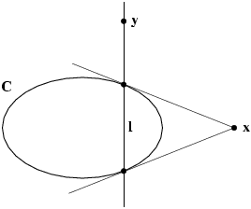
Pole-polar relationship
The polar line l=Cx of the point x with respect to the conic C intersects the conic in two points. The two lines tangent to C at these points intersect at x

Slide 21
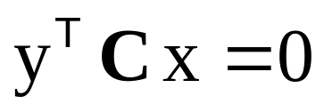
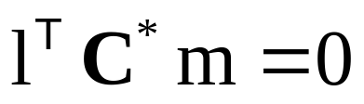
Correlations and conjugate points
A correlation is an invertible mapping from points of P² to lines of P². It is represented by a 3x3 non-singular matrix A as l=Ax
Conjugate points with respect to C
(on each others polar)
Conjugate points
with respect to C*
(through each others pole)

Slide 22








Projective conic classification
Diagonal | Equation | Conic type
(1,1,1) |  | improper conic
(1,1,-1) |  | circle
(1,1,0) |  | single real point
(1,-1,0) |  | two lines
(1,0,0) |  | single line

Slide 23
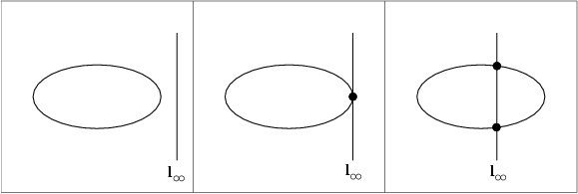
Affine conic classification
ellipse
parabola
hyperbola

Slide 24
Chasles’ theorem
Conic = locus of constant cross-ratio towards 4 ref. points
A
B
C
X
D

Slide 25
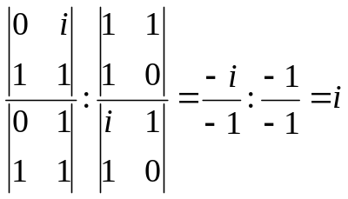
Iso-disparity curves
X_{i}
X_{j}
X₀
X₁
C₁
C₂
X∞

Slide 26
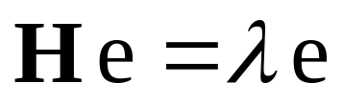


Fixed points and lines
(eigenvectors H =fixed points)
(λ₁=λ₂ ⇒ pointwise fixed line)
(eigenvectors H^{-T} =fixed lines)

Slide 27





Next course:
Projective 3D Geometry
Points, lines, planes and quadrics
Transformations
П∞, ω∞ and Ω ∞

